Slide 1
Topic 29:
Remote Sensing
29.1 Production and use of X-rays
29.2 Production and uses of ultrasound
29.3 Use of magnetic resonance as an imaging technique

Slide 2
COMPUTED TOMOGRAPHY
CT SCAN

Slide 3
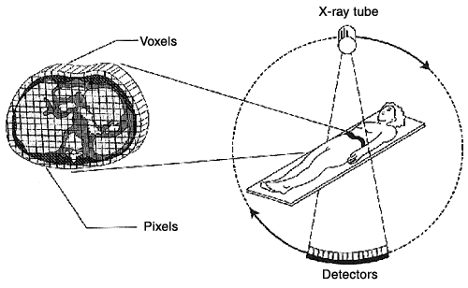
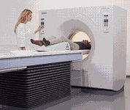
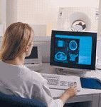
What is a CT Scan?
CLICK
CT scanning or computed tomography, involves an X-ray tube that turns 360 degrees around the patient. (Also known as CAT)
In this way, information is acquired from different angles in a plane.
This information is reconstructed by computer technique into a slice of cross-sectional image of the body.
Images of successive slices can be combined to give a three-dimensional image. The three-dimensional image can be rotated and viewed from any angle.

Slide 4
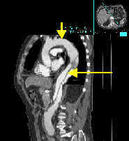
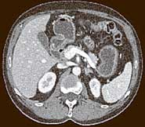
Use of CT Scans
CT Image of the Abdomen
CT Image of the Thorax - Aorta
CT is fast, patient-friendly and has the unique ability to image a combination of soft tissue, bone, and blood vessels.
Physician can selectively "window" the digital CT images on the computer monitor to look at the soft tissue, then the bone and then the blood vessels, as needed.
For example, CT is used extensively for diagnosing problems of the inner ears and sinuses because the anatomy of the inner ear and sinuses is made up of delicate soft tissue structure and very fine bones.
It is also the preferred method for diagnosing lung, liver and pancreas cancer.

Slide 5
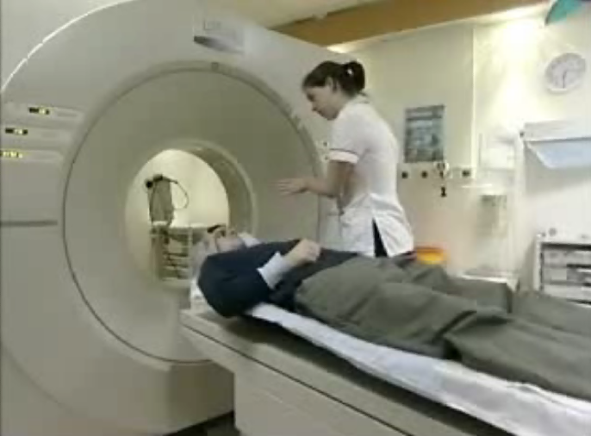
A CT Scan Demo

Slide 6
Advances of CT Scan
Original CT scanners (1974 to 1987) would spin 360° in one direction and make an image (or slice), then spin 360° in the other direction to make a second slice. Between each slice, the machine would stop completely and reverse directions while the patient table was moved forward by an increment equal to the thickness of a slice.
In the mid-1980s, an innovation called the "power slip ring" allowed scanners to rotate continuously. This development led to a new type of CT called "spiral" or "helical" scanning.
The spiral or helical scanning dramatically increased its speed and effectiveness.

Slide 7
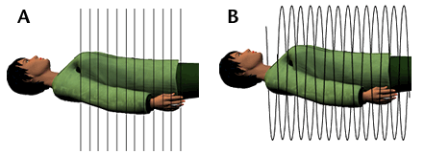
The Helical Scanning
Figure A: Conventional CT Scanning
Conventional CT scans take pictures of slices of the body (like slices of bread). These slices are a few millimeters apart.
Figure B: Helical CT Scanning
The helical CT scan takes continuous pictures of the body in a rapid spiral motion, so that there are no gaps in the pictures collected.

Slide 8
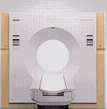

Structure of a CT Scanner
CLICK
The Outside View of a Modern CT System
The Inside View of a Modern CT System

Slide 9
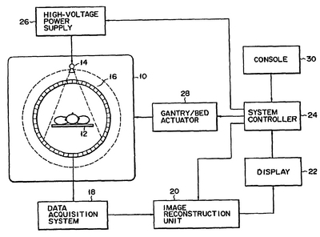
Block Diagram

Slide 10
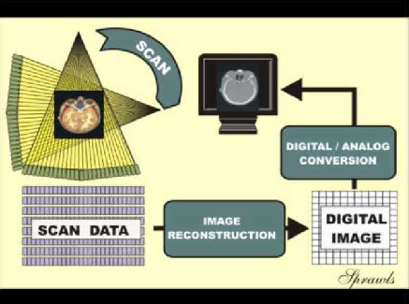
CT Image Formation
CLICK
The formation of a CT image is a distinct three phase process.
The scanning phase produces data, but not an image.
The reconstruction phase processes the acquired data and forms a digital image.
The visible and displayed analog image (shades of grey) is produced by the digital-to analog conversion phase.

Slide 11
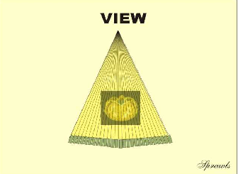
A CT X-ray Beam View
The projection of the fan-shaped x-ray beam from one specific x-ray tube focal spot position produces one view.
Many views projected from around the patient's body are required in order to acquire the necessary data to reconstruct an image.

Slide 12
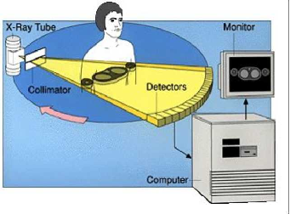
The CT Imaging Process Using Views
As the x-ray beam is scanned around the body, forming many views, the data recorded by the detectors are stored in a computer memory for later image reconstruction.

Slide 13
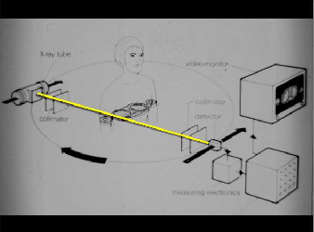
A Ray
A ray is the pathway of a portion of the x-ray beam from one specific focal-spot position to a specific detector position.
As the ray passes through the body, it measures the total x-ray attenuation (or penetration) along it's path. This is the data recorded by the detector.
A view, as seen previously, is made-up of many individual rays.

Slide 14
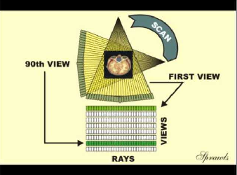
A Complete Scan
A complete scan is formed by rotating the x-ray tube completely around the body and projecting many views.
Each view produces one "profile" or line of data as shown here.
The complete scan produces a complete data set that contains sufficient information for the reconstruction of an image.
In principle, one scan produces data for one slice image. However, with spiral/helical scanning, there is not always a one-to-one relationship between the number of scans around the body and the number of slice images produced.

Slide 15
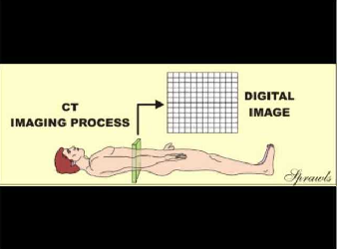
The CT Image
The principle objective of CT imaging is to produce a digital image (a matrix of pixels) for a specific slice of tissue.
During the image reconstruction process, the slice of tissue is divided into a matrix of voxels (volume elements).
As we will see later, a CT number is calculated and displayed in each pixel of the image. The value of the CT number is calculated from the x-ray attenuation properties of the corresponding tissue voxel.

Slide 16
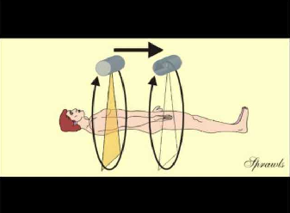
X-ray Tube Motions
There are two distinct motions of the x-ray beam relative to the patient's body during CT imaging.
One motion is the scanning of the beam around the body as we have just seen.
The other motion is the movement of the beam along the length of the body. This is achieved by moving the body through the beam as it is rotating around.

Slide 17
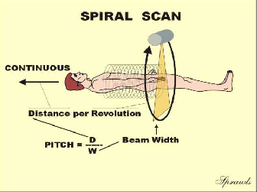
Spiral/Helical Scanning
Spiral or helical scanning is a more recently developed mode and is used for many procedures.
The patient's body is moved continuously as the x-ray beam is scanned around the body.
This motion is controlled by the operator selected value of the pitch factor.
As illustrated, the pitch value is the distance the body is moved during one beam rotation, expressed as multiples of the x-ray beam width or thickness.
If the body is moved 10 mm during one rotation, and the beam width is 5 mm, the pitch will have a value of 2.

Slide 18
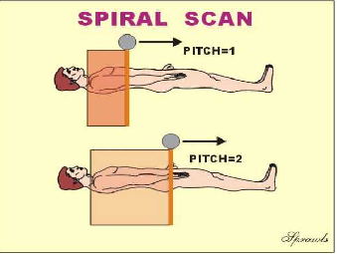
Changing the Pitch
As we see here, when the pitch is increased, the x-ray beam appears to move faster along the patient's body.
During the same time (as illustrated), the x-ray beam will be spread over more of the body when the pitch is increased. This has three major effects.
  Scan time will be less to cover a specific body volume.
  The radiation is less concentrated so dose is reduced.
  There will not be as much "detail" in the data and image quality might be reduced.

Slide 19
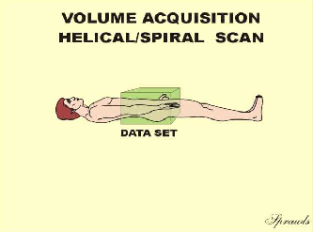
Volume Data Sets
A major advantage of spiral/helical scanning is that it produces a continuous data set extending over some volume of the patient's body.
The data set is not broken up into slices as with the scan/step slice acquisition method.
As we will soon see, the volume data set can be sliced many ways later during the image reconstruction phase.

Slide 20
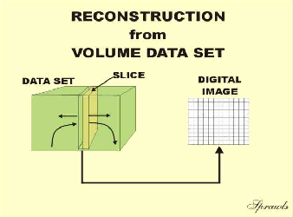
Reconstruction from Volume Data Sets
A major advantage of spiral scanning is that the thickness, position, and orientation of image slices can be adjusted during the reconstruction phase.
Images of overlapping slices can be created.
The reconstruction can be repeated to produce images with different spatial characteristics.

Slide 21
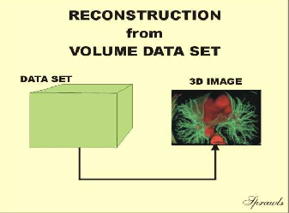
3-D Image Reconstruction
A volume data set can be used to reconstruct 3-D images.
A general requirement for good-quality 3-D images is that the data set have "good detail" in the long patient axis direction. This is achieved by scanning with thin beams and relatively low pitch values.

Slide 22
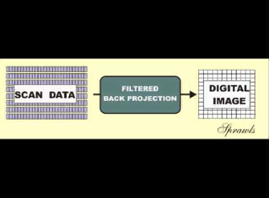
Image Reconstruction
Image reconstruction is the phase in which the scan data set is processed to produce an image. The image is digital and consist of a matrix of pixels.
Filtered back projection is the reconstruction method used in CT.
"Filtered" refers to the use of the digital image processing algorithms that are used to improve image quality or change certain image quality characteristics, such as detail and noise.
"Back projection" is the actual process used to produce or "reconstruct" the image.

Slide 23
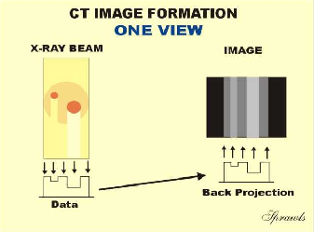
The Concept of Back Projection
This is a very simple example illustrating the principle of image reconstruction by back projection.
We start with one scan view through a body section (like a head) that contains two objects. As we know, the data produced is not a complete image, but a profile of the x-ray attenuation by the objects.
Let's now take this profile and attempt to draw an image by "back projecting" the profile onto our image surface.
As we see, there is only enough information in the profile to allow us to draw in streaks, kind of like shadows across the image area.

Slide 24
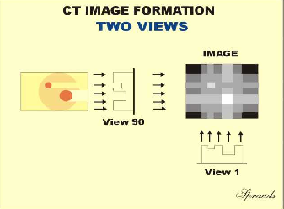
Image Reconstruction with Two Views
We have now rotated the x-ray beam around the body by 90º and obtained another view.
If we now back project this profile onto our image area we see the beginnings of an image showing the two object.
Two views does not give us a high-quality image.
Several hundred views are used to produce clinical CT images.

Slide 25
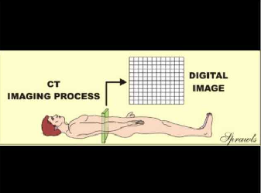
The CT Image
As we have already discovered, the CT image is a digital in the form of a matrix of pixels.
A part of the reconstruction process is the calculation of CT number values for each image pixel.

Slide 26
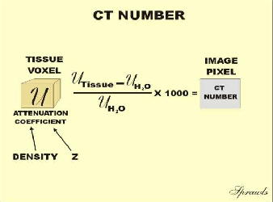
CT Numbers
Note that water is the reference material for CT numbers and has an assigned value of zero.
Tissues or materials with attenuation (density) greater than water will have positive CT numbers. Those that are less dense will have negative CT numbers.
The CT numbers are calculated from the x-ray linear attenuation coefficient values for each individual tissue voxel. It is the attenuation coefficient that is first calculated by the reconstruction process and then used to calculate the CT number values.
X-ray attenuation depends on both the density and atomic number (Z) of materials and the energy of the x-ray photons. For CT imaging a high KV (like 120-140) and heavy beam filtration is used. This minimizes the photoelectric interactions that are influenced by the Z of a material. Therefore, CT numbers are determined by the density of the tissues or materials.

Slide 27
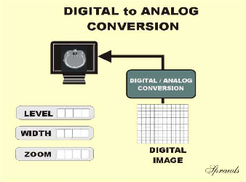
The Digital To Analog Conversion Phase
In this phase the digital image, consisting of a matrix of pixels with each pixel having a CT number, is converted into a visible image represented by different shades of grey or brightness levels.
There are several adjustable factors that control this process.
The windowing has level and width controls
The area of the digital image that is actually displayed is controlled by the zoom control.

Slide 28
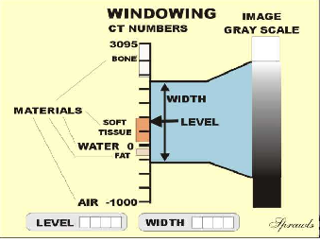
Windowing
The window is the range of CT numbers that will be displayed with the different shades of gray, ranging from black to white.
Tissues within the window will have different shades of gray (brightness) and will have visible contrast.
All tissues and materials that have CT numbers above the window will be all white and no contrast within this range. All that have CT numbers below the window will be all black and without contrast.
The level control adjust the center of the window.
The width control adjust the range of CT numbers that will be displayed with contrast. The width controls the contrast in the displayed image. Reducing window width increases the displayed image contrast among the tissues.
The ability to window is what gives CT a very high contrast sensitivity. This is because a window can be set to display and make visible very small differences in tissue densities.

Slide 29
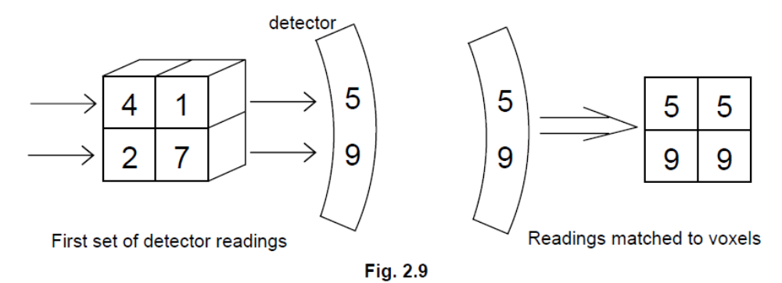
Example 1: View 1

Slide 30
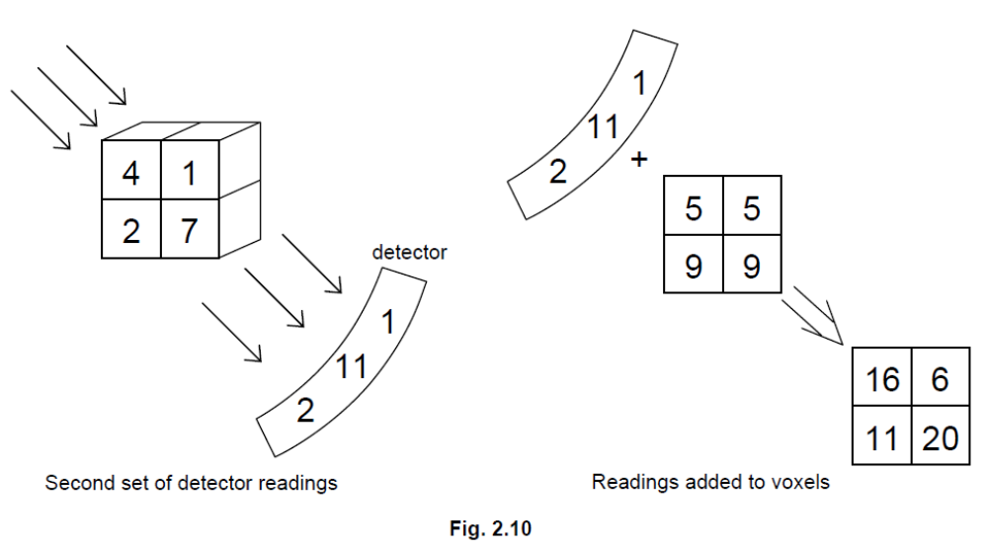
Example 1: View 2 (45º clockwise)

Slide 31
Example 1: View 3 (90º clockwise)

Slide 32
Example 1: View 4 (135º clockwise)

Slide 33
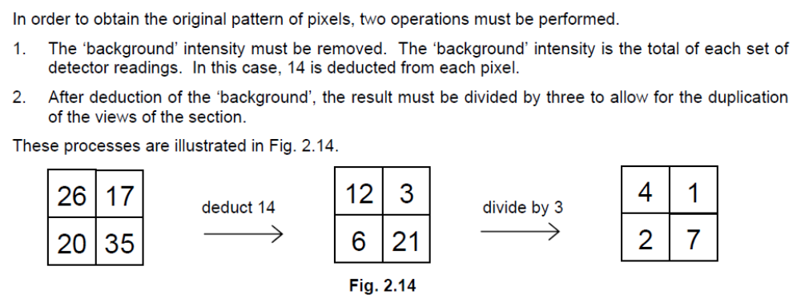
Obtaining the Original Pattern

Slide 34
Example 2
7
13
7 7
13 13
3
4
8
5
Try this example like the previous, you should get back the same pixel numbers.

Slide 35
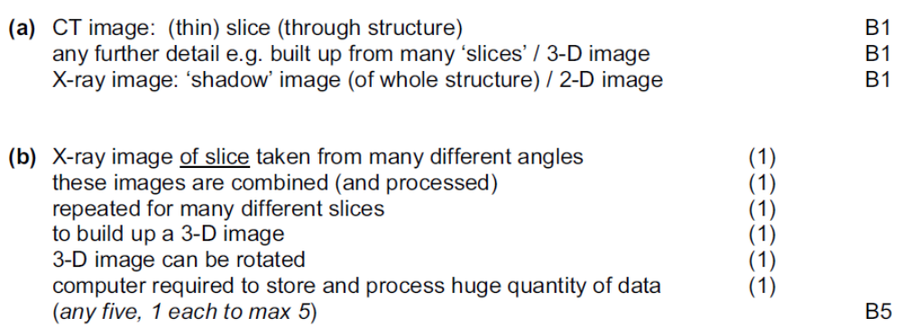
CT Scan (P4-Nov 2008)
(a) Distinguish between the images produced by CT scanning and X-ray imaging. [3]
(b) By reference to the principles of CT scanning, suggest why CT scanning could not be developed before powerful computers were available. [5]
Solution:

Slide 36
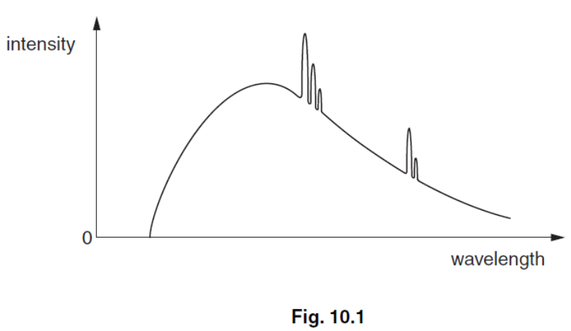
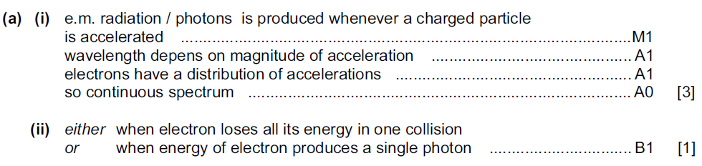
X-Ray (P42-Nov 2009) (1/2)
(a) A typical spectrum of the X-ray radiation produced by electron bombardment of a metal target is illustrated in Fig. 10.1.
Explain why
(i) a continuous spectrum of wavelengths is produced, [3]
(ii) the spectrum has a sharp cut-off at short wavelengths. [1]
Solution:

Slide 37
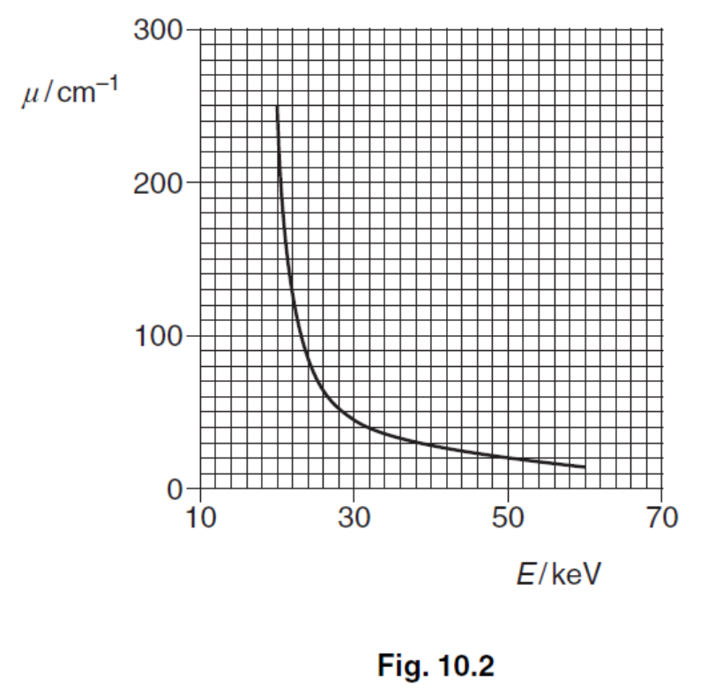
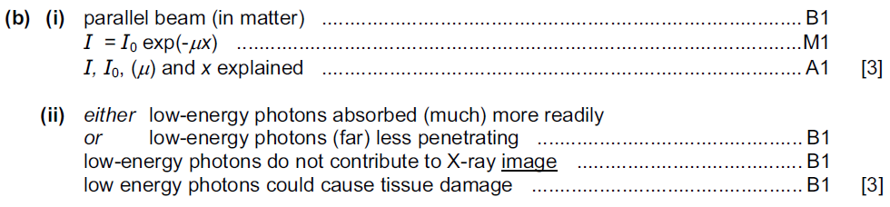
X-Ray (P42-Nov 2009) (2/2)
(b) The variation with photon energy E of the linear absorption coefficient of X-rays in soft tissue is illustrated in Fig. 10.2.
(i) Explain what is meant by linear absorption coefficient [3]
(ii) For one particular application of X-ray imaging, electrons in the X-ray tube are accelerated through a potential difference of 50 kV. Use Fig. 10.2 to explain why it is advantageous to filter out low-energy photons from the X-ray beam. [3]
Solution:

Slide 38
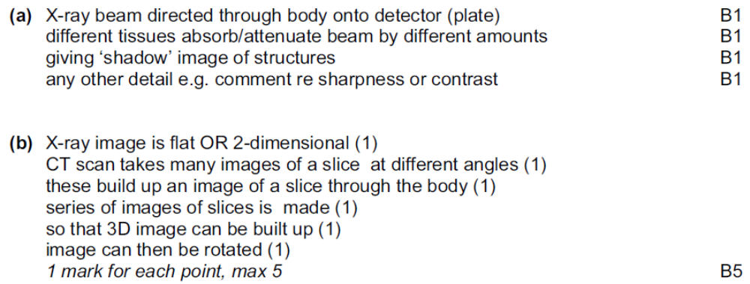
X-Ray (P4-June 2007) (2/2)
(a) Explain the principles behind the use of X-rays for imaging internal body structures.
(b) Describe how the image produced during CT scanning differs from that produced by X-ray imaging.
Solution:

Slide 39
The End

